Slide 1
Time Interval Aware Self-Attention for Sequential Recommendation
ADVISOR: JIA-LING KOH
PRESENTER: CHENG-WEI CHEN
SOURCE: WSDM’20
DATE: 2021/11/16

Slide 2
Outline
Introduction
Method
Experiment
Conclusion

Slide 3
Outline
Introduction
Problem
Previous Work
Target

Slide 4
Problem
Probability of next items user will interacts with
User u
Output
Item i
Input
Previous n items sequence records

Slide 5
Previous Work
Previous sequential recommenders discard timestamps and preserve only the order of items (assume that all adjacent items in a sequence have the same time intervals.)
Items with more recent timestamps will have more influence on the next item

Slide 6
Target
Probability of next items user will interacts with
Output
User u
Previous n items & time sequence records
Item i
Input
Time t
2021/9/26
15:00
2021/10/2
18:20
2021/10/26
12:50
2021/11/3
14:20

Slide 7
Outline
Introduction
Method
Experiment
Conclusion

Slide 8
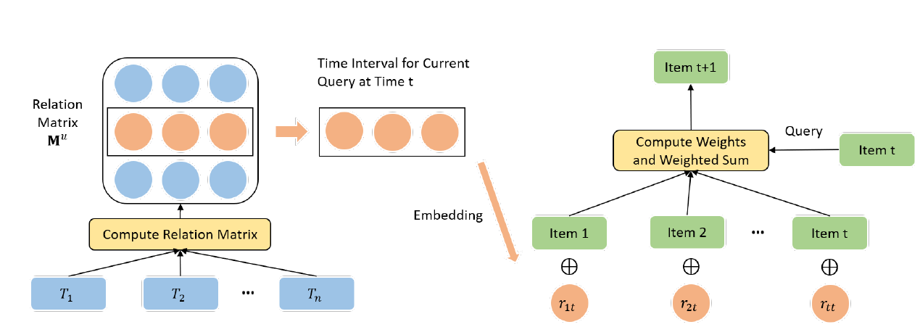
Architecture
Time interval aware
Self-Attention
Compute time interval

Slide 9
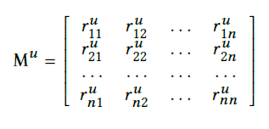
Compute time interval
Item sequence
Time sequence
(consider the most recent n actions)
Time interval
The maximum relative time interval

Slide 10
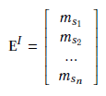
Embedding layer (before self attention)
Position and relative time interval embedding matrices(for Keys and Values)
Item embedding matrix
(for Query, Key, Value)

Slide 11
Time Interval-Aware Self-Attention
Attention
Q
K
V
Vj =

Slide 12
Endow non-linearity to the model

Slide 13
Prediction layer
Users’ preference score of item i
Representation to given the first t items and their time intervals
Embedding of item i

Slide 14
Loss function
Ground-Truth Item
Negative Sampling
Different User
Different Time

Slide 15
Outline
Introduction
Method
Experiment
Conclusion

Slide 16
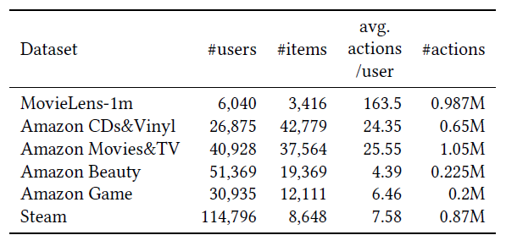
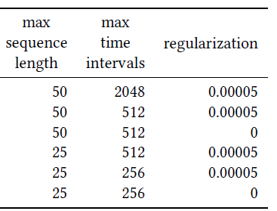
Dataset
n(sec3.2) k(sec3.2) λ(formula14)

Slide 17
Experiment
Randomly sample 100 negative items, and rank these items with the ground-truth item.
Notes:
MARank: 有用self attention，capture individual- and unionlevel item dependency

Slide 18
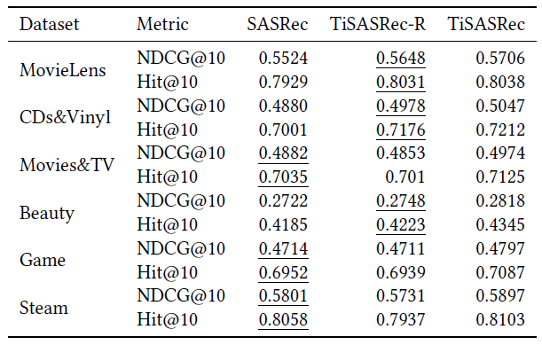
Experiment
No consider absolute positions

Slide 19
Experiment
X
Use timestamps

Slide 20
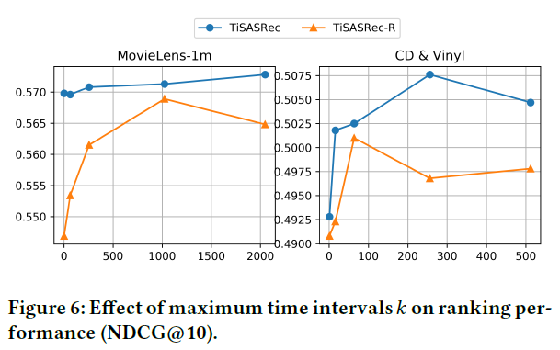
Experiment

Slide 21
Outline
Introduction
Method
Experiment
Conclusion

Slide 22
Conclusion
View user’s interactions history as a sequence with different time intervals, and model different time intervals as relations between any two interactions.
Design time interval aware self-attention mechanism to learn the weight of different items, absolute positions and time intervals to predict future items.
Conduct experiments to study the impact of absolute positions and relative time intervals on the performance, and show that it outperforms state-of-the-art baselines in terms of two ranking metrics.

